Slide 1


Start
CE 72.12 Finite Element Methods in Engineering
Course Project 2024
Instructor: Dr.Chaitanya Krishna
Peerawut Watsaratiyanont
Saurav Kumar Shrestha
Jutamas Taweesint
Po Po Han Myint
Chhayleang Ly
st124069 st124344
st124010
st124271
st124112
Date : 07/04/2024 (SAT)
Presented by :

Slide 2
01
Project Recap
Assigned the task to mesh a column with tetrahedral elements
Apply a cyclic displacements at the top of the column to produce the required displacements on either side
Meshing (Hand, Gmsh)
File conversation
Derivation
Pre-Processing
What have we done?
Solver

Slide 3
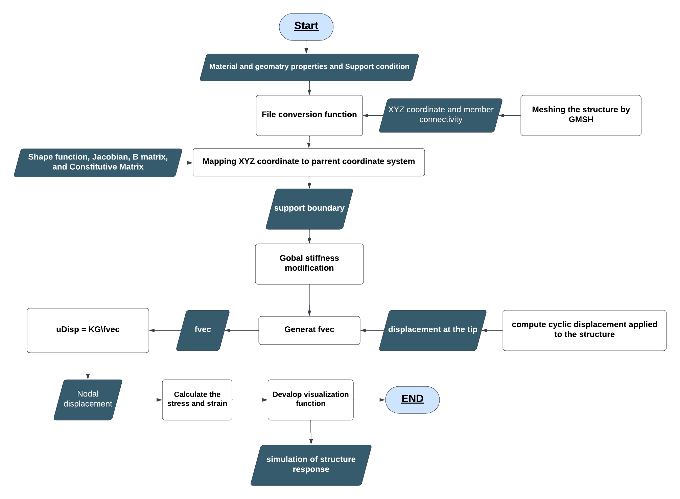
02
ILLUSTRION CHART

Slide 4

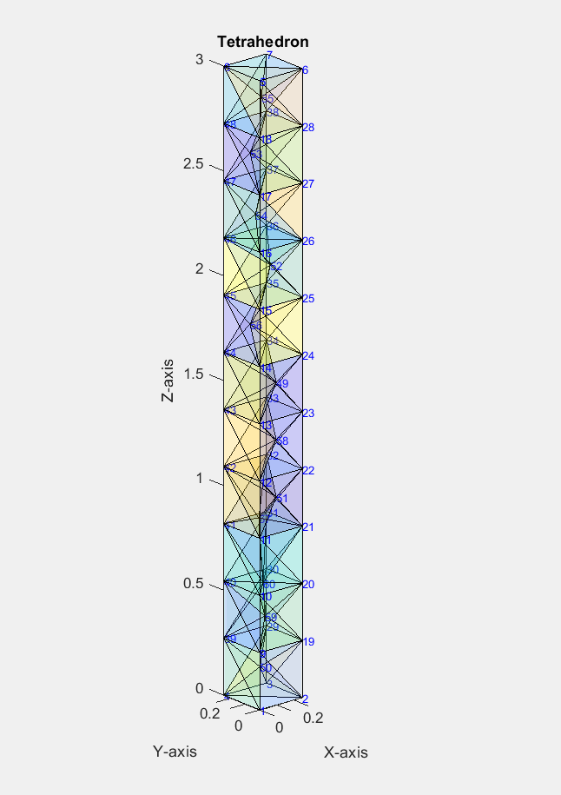
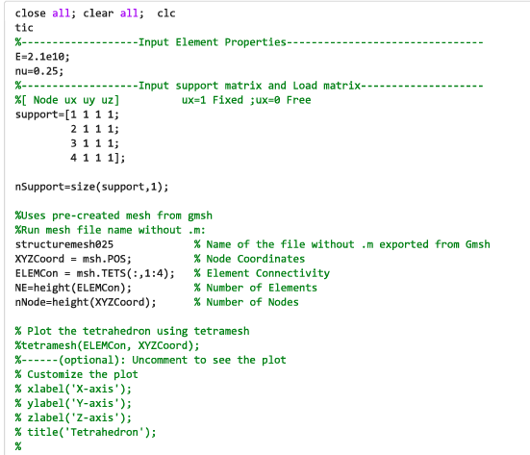
Development on Coding( Solver Part )
Pre-Processer Code
Putting the .m file from gmsh to matlab directly to get node points and element connectivity.
03

Slide 5
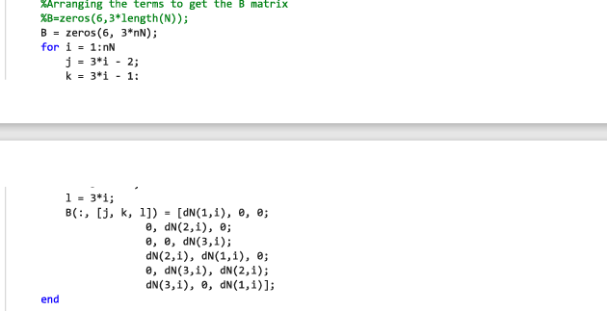
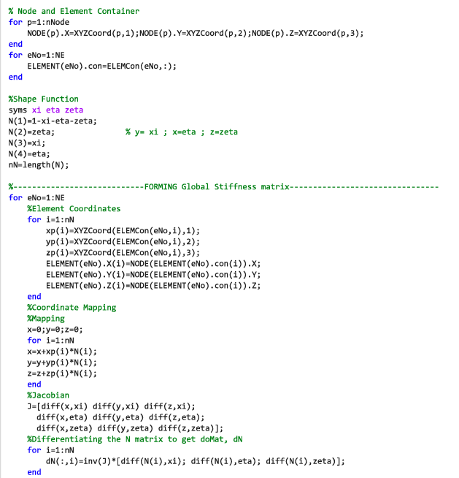
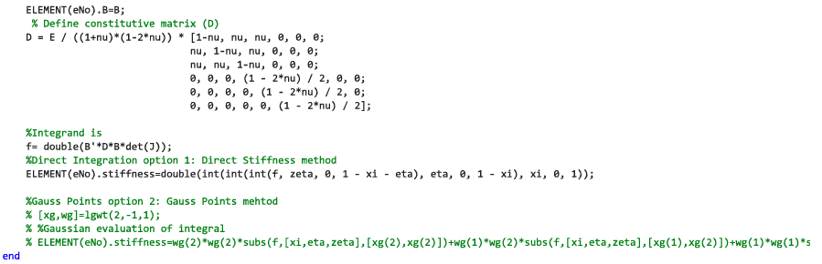
Development on Coding( Solver Part )
Solver Code( B Matrix & D Matrix)
Strain displacement Matrix
Shape function
Constitutive relationship Matrix
Jacobian
Have 2 Option for Integral part
04

Slide 6
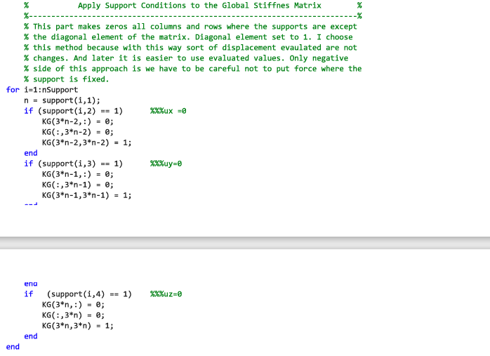
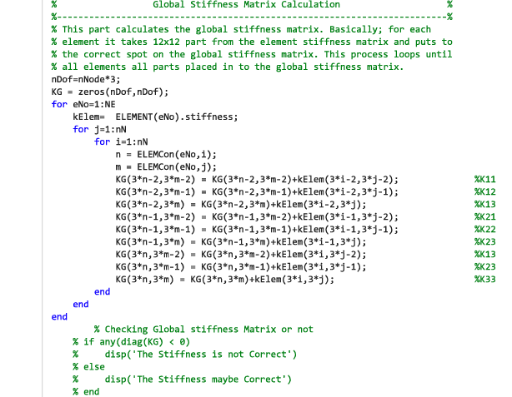
Development on Coding( Solver Part )
Solver Code(KG)
Form the global stiffness matrix
Modified the global stiffness matrix by apply the boundary condition from the input
Option to check the
global stiffness matrix
05

Slide 7
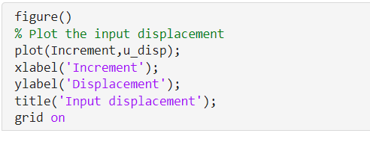
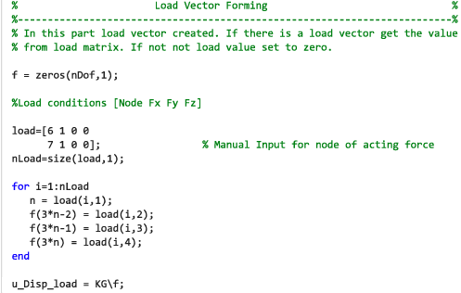
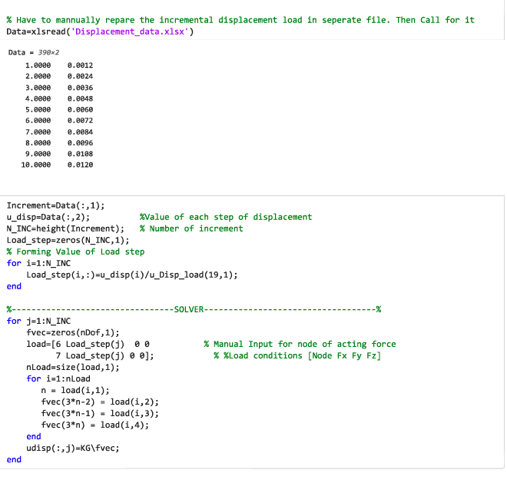
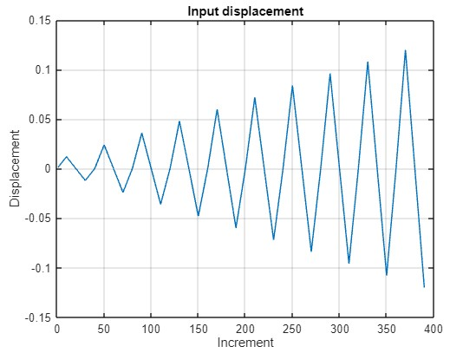
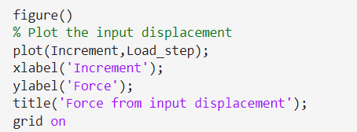
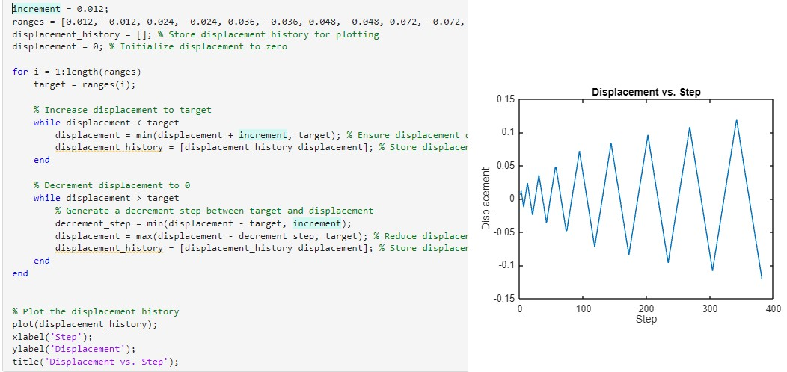
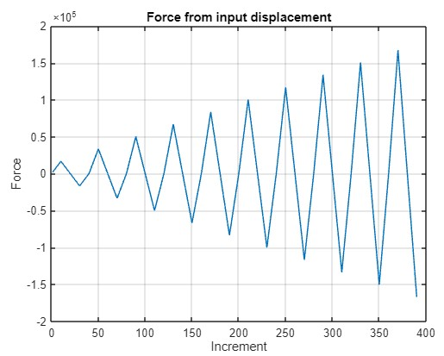
Development on Coding( Solver Part )
Input any displacement data (incremental steps)
Trial find the force for the input displacement data in 1 unit force
Loop find all local displacement for every increment
Export to excel
06

Slide 8
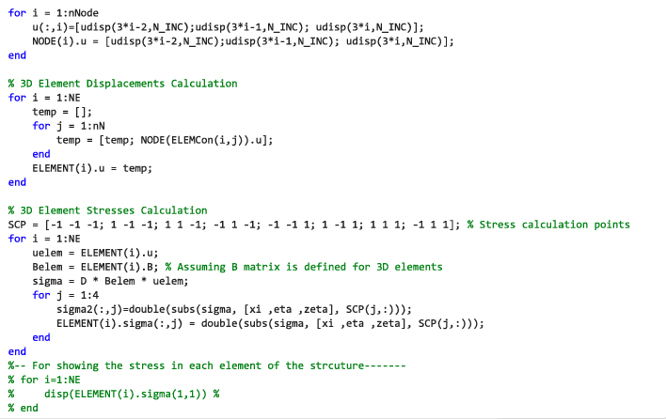
Development on Coding( Solver Part )
Solver Code
Stress of all element
Option to call to stress values
07

Slide 9
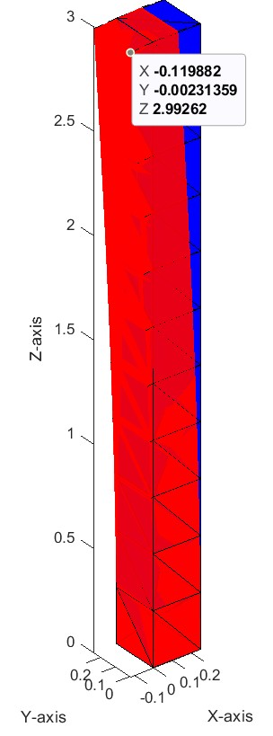
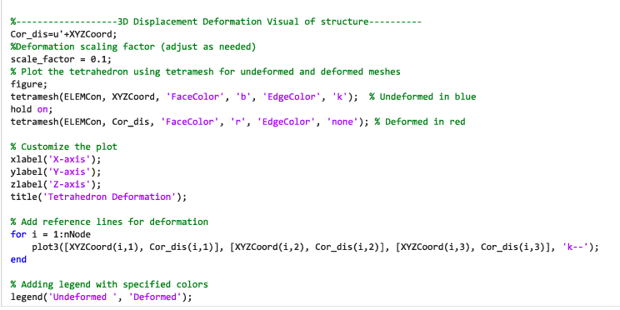
08
Post Processer
Deformed
Undeformed
3D Displacement Deformation visual of Structure

Slide 10
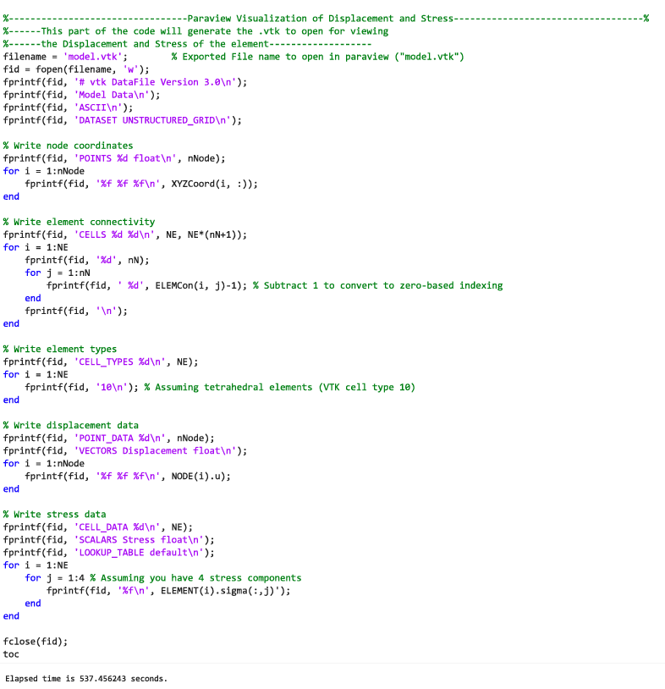
09
Post Processer
Conversion to .vtk file

Slide 11
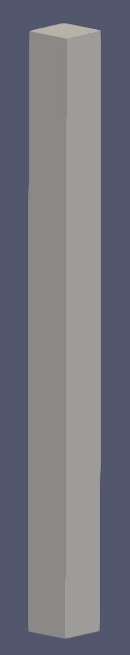
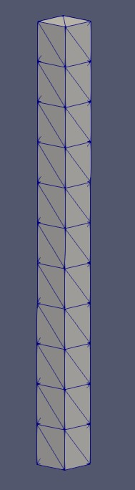
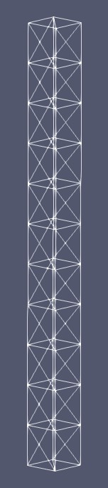
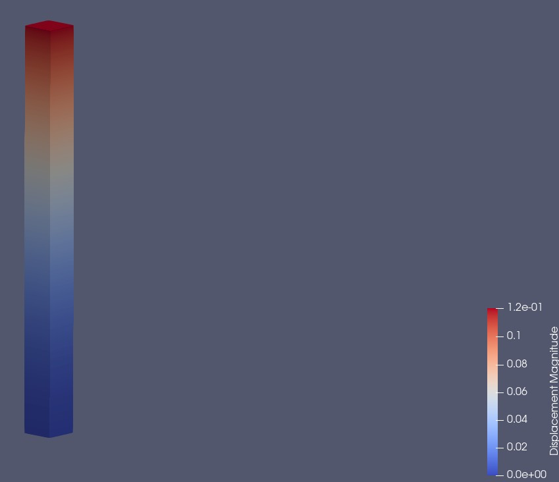
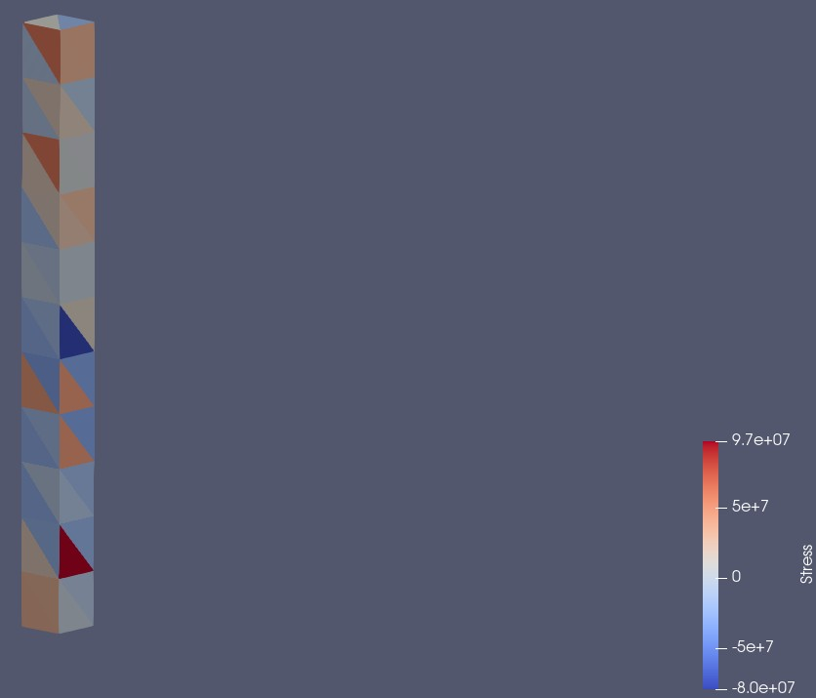
10
Post Processing (Visualization On Paraview)
3D Solid View
Displacement
Stress Contour

Slide 12
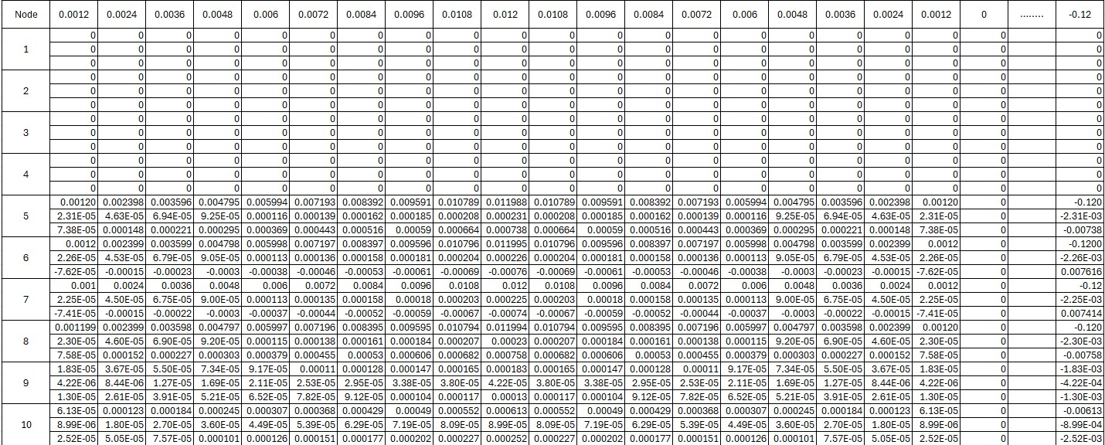
11
Result of Displacement

Slide 13
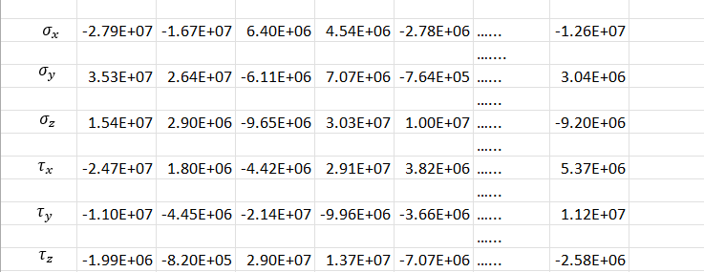
11
Result of Stresses

Slide 14
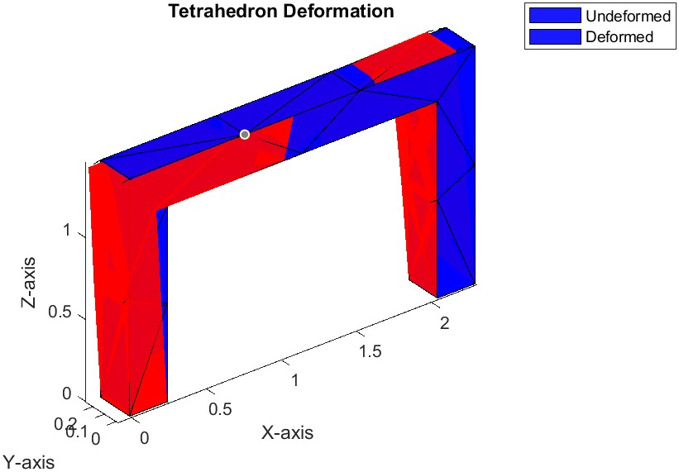
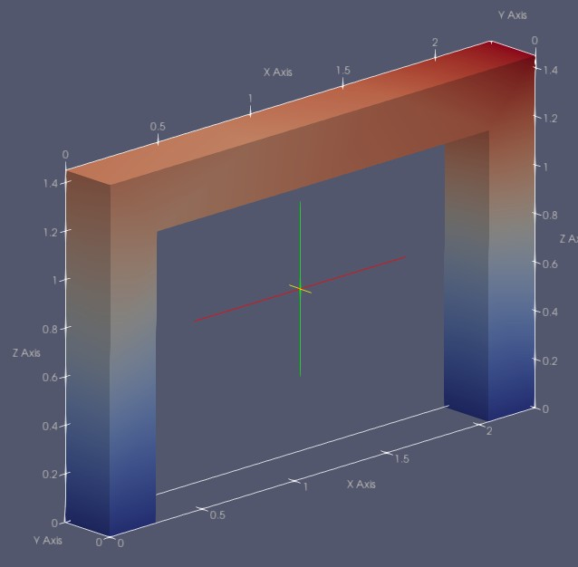
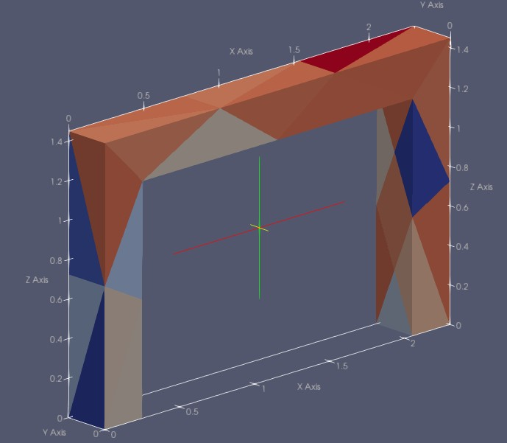
06
Utilization
3D Displacement Deformation visual of other Structure
Visualization From Paraview

Slide 15
06
Discussion
The displacement that we got at the top node is the same as the last incremental load displacement given in the question. This is perhaps because the graph is linear.
Since our element is linear, the displacement is constant and hence the strain, an in turn the stress is also constant over the body of the elements.
The main hurdle in our path was certainly the unloading part. It was very tricky to figure out. Luckily, the force deformation relation for us was linear so we manually created the cyclic displacement which we later used.
When using our script in another structure, we found that the script works effectively.

Slide 16
Finish
Thank You

